Slide 1
Digital Portfolio
STUDENT NAME: A.Rakesh Kumar
REGISTER NO AND NMID: 212400224/7DCB8A6B34F1816B2E74FAFCAAECC3DB
DEPARTMENT: BCA
COLLEGE: DRBCCC HINDU COLEGE/University of Madras

Slide 2
PROJECT TITLE
Data Analyst Portfolio

Slide 3


AGENDA
Problem Statement
Project Overview
End Users
Tools and Technologies
Portfolio design and Layout
Features and Functionality
Results and Screenshots
Conclusion
Github Link
3/21/2024 Annual Review

Slide 4

PROBLEM STATEMENT
Organizations often struggle to make informed decisions due to the large volume of unstructured or complex data. The challenge is to analyze diverse datasets, uncover actionable insights, and present them in a clear, interactive format that supports data-driven decision-making, identifies trends, and highlights key performance indicators.

Slide 5

PROJECT OVERVIEW
This project focuses on analyzing [Dataset/Domain] to uncover meaningful insights and support data-driven decisions. Using tools like Power BI, Excel, SQL, and Python, I cleaned and transformed the data, performed exploratory analysis, and created interactive dashboards to visualize trends, patterns, and key performance indicators. The project highlights my ability to translate complex data into actionable insights for business impact.

Slide 6

WHO ARE THE END USERS?
The end users of this project are business managers, HR leaders, and decision-makers who need actionable insights to improve performance, optimize operations, and make informed strategic decisions. The dashboards and analyses are designed to be interactive and user-friendly, enabling stakeholders to quickly explore trends, monitor KPIs, and identify opportunities for improvement.

Slide 7

TOOLS AND TECHNIQUES
Data Cleaning & Transformation: Excel, Python (Pandas, NumPy)
Data Analysis & Modeling: SQL, Python
Data Visualization & Dashboarding: Power BI, Tableau
Techniques Applied: Exploratory Data Analysis (EDA), Trend Analysis, KPI Monitoring, Interactive Dashboard Design, DAX Calculations

Slide 8
POTFOLIO DESIGN AND LAYOUT
The portfolio is designed with a clean, modern, and user-friendly layout to highlight projects effectively. Each project section includes problem statement, project overview, tools & techniques, key insights, and visualizations. Interactive elements like dashboards, charts, and filters are showcased to demonstrate practical data analysis skills. The design emphasizes clarity, consistency, and easy navigation for recruiters and stakeholders.
8

Slide 9
FEATURES AND FUNCTIONALITY
Interactive Dashboards: Filter and explore data by role, department, age, or other variables
Visual Insights: Charts, graphs, and KPI indicators for quick decision-making
Trend Analysis: Identify patterns in attrition, sales, or performance metrics
Data-Driven Recommendations: Actionable insights for stakeholders
User-Friendly Design: Clean layout with easy navigation for end users

Slide 10
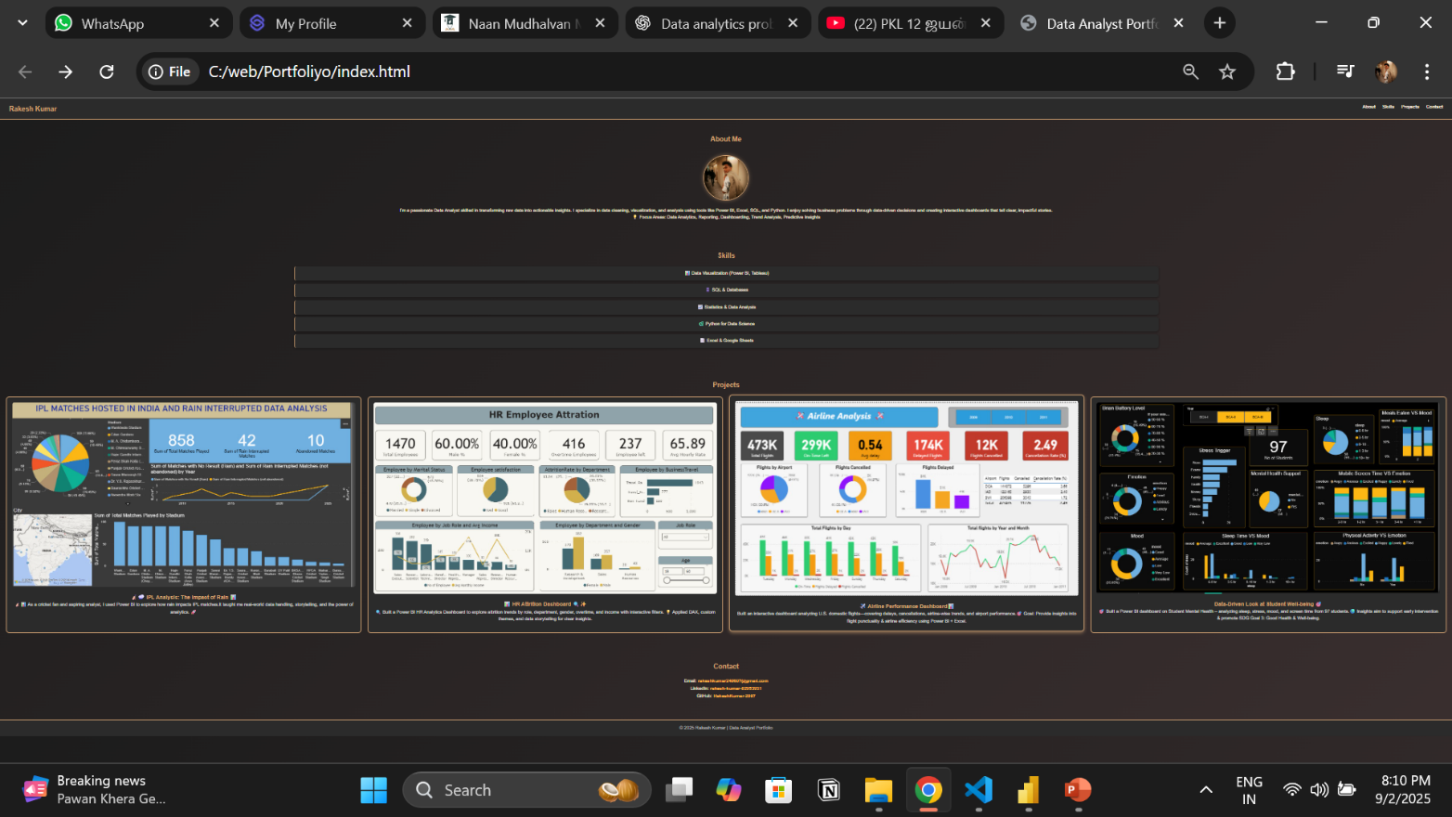

RESULTS AND SCREENSHOTS
3/21/2024 Annual Review
10

Slide 11
CONCLUSION
This project demonstrates the ability to transform raw data into actionable insights using data cleaning, analysis, and visualization techniques. The interactive dashboards and visualizations provide stakeholders with clear, data-driven insights to support informed decision-making, monitor trends, and identify opportunities for improvement.
GitHub Link : https://github.com/RakeshKumar-2007/TNSDC-FWD-DP.git
11

